Slide 1
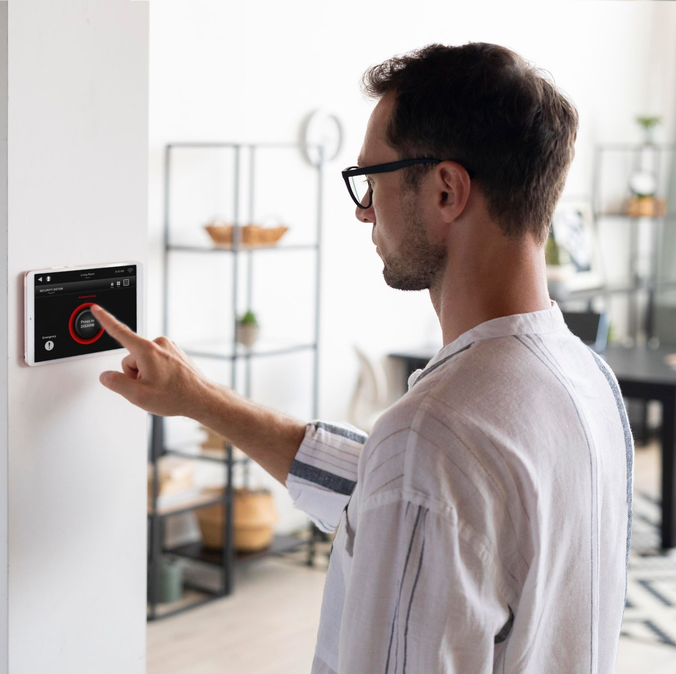
Examining Synchronization Mechanisms for Smart Home Application
By: Artiom Suruc, Tudor Ciutacu, Anna Manucharyan

Slide 2
TABLE OF CONTENTS
Introduction
Architecture
01
04
Applications
Results
02
05
Our project
Conclusion
03
06
Brief overview of smart home applications
Details
Smart Home Device Applications in real life
Experiments and data collection
Description of our project design
Future extensions of the projects

Slide 3
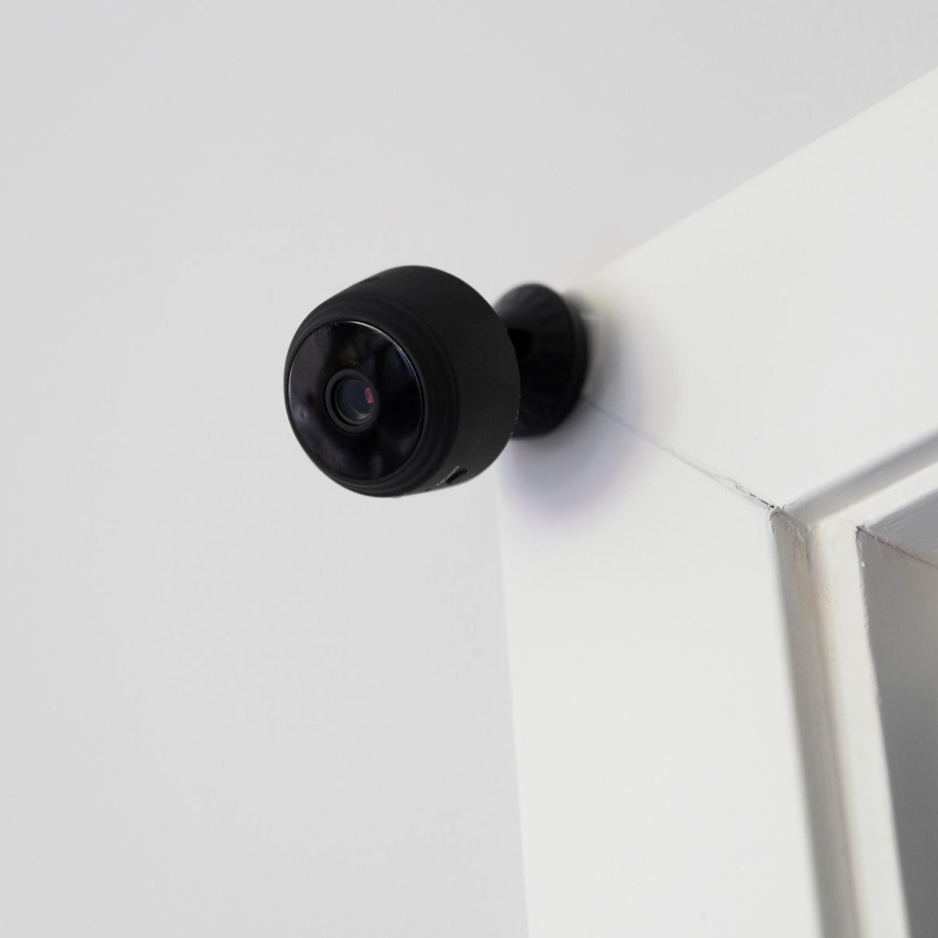
Smart Home applications
Smart Home applications transform traditional homes into technologically advanced and interconnected environments
A network of devices and systems automate and control various aspects of daily life, such as:
lighting,
security,
temperature,
entertainment, and more

Slide 4
Robust synchronization mechanisms are needed to ensure seamless communication and coordination between different devices within a smart home system
Without proper synchronization, smart home devices may encounter conflicts, delays, or inconsistent behavior, undermining the overall functionality and usability of the system.

Slide 5
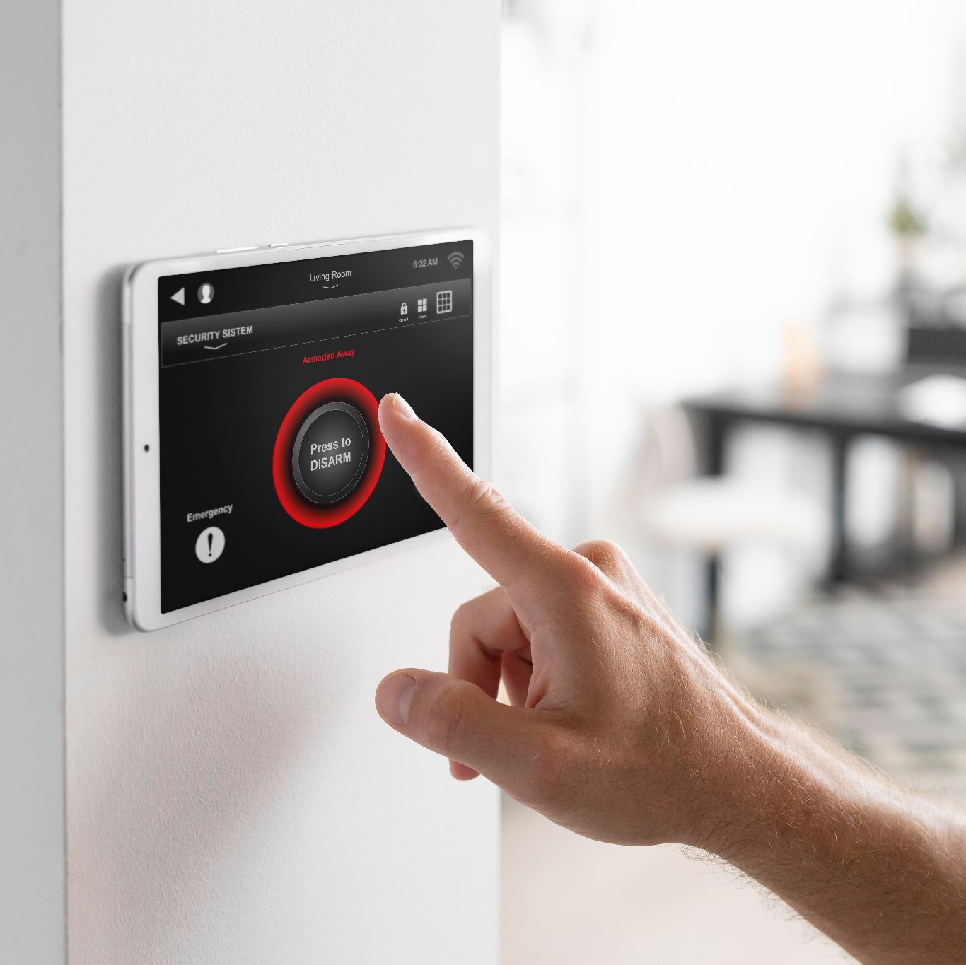
Smart Home Systems
Advantages | Challenges
Energy efficient | Costly
Secure | Battery life
Comfort and customisation | Internet dependence
Ease of access and convenience | Privacy concern

Slide 6
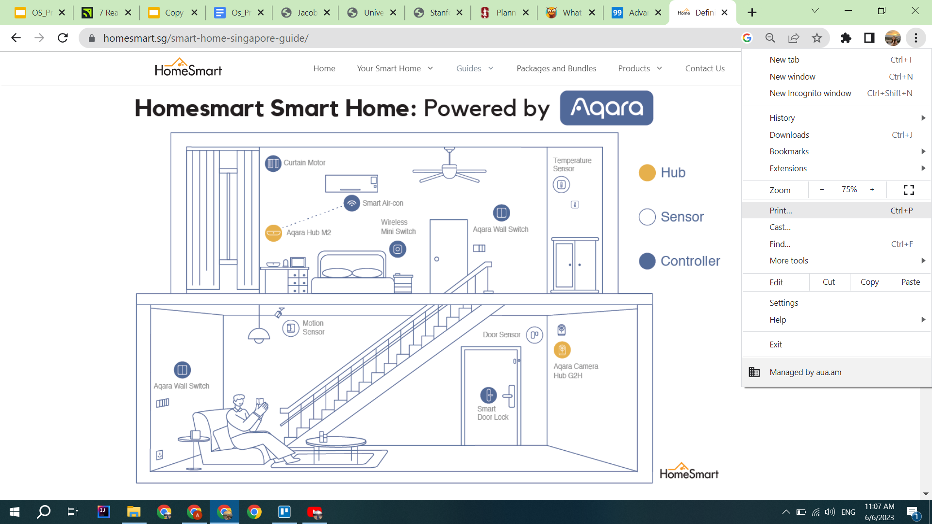
Example of a Smart Home Application: Singapore
Currently, the smart household penetration in Singapore is approximately 33.4% and Statista expects the number to hit 68% by 2026
It is estimated that Smart Home application reduces its energy costs by 5 to 10 percent

Slide 7
WHAT WE ARE WORKING ON

Slide 8
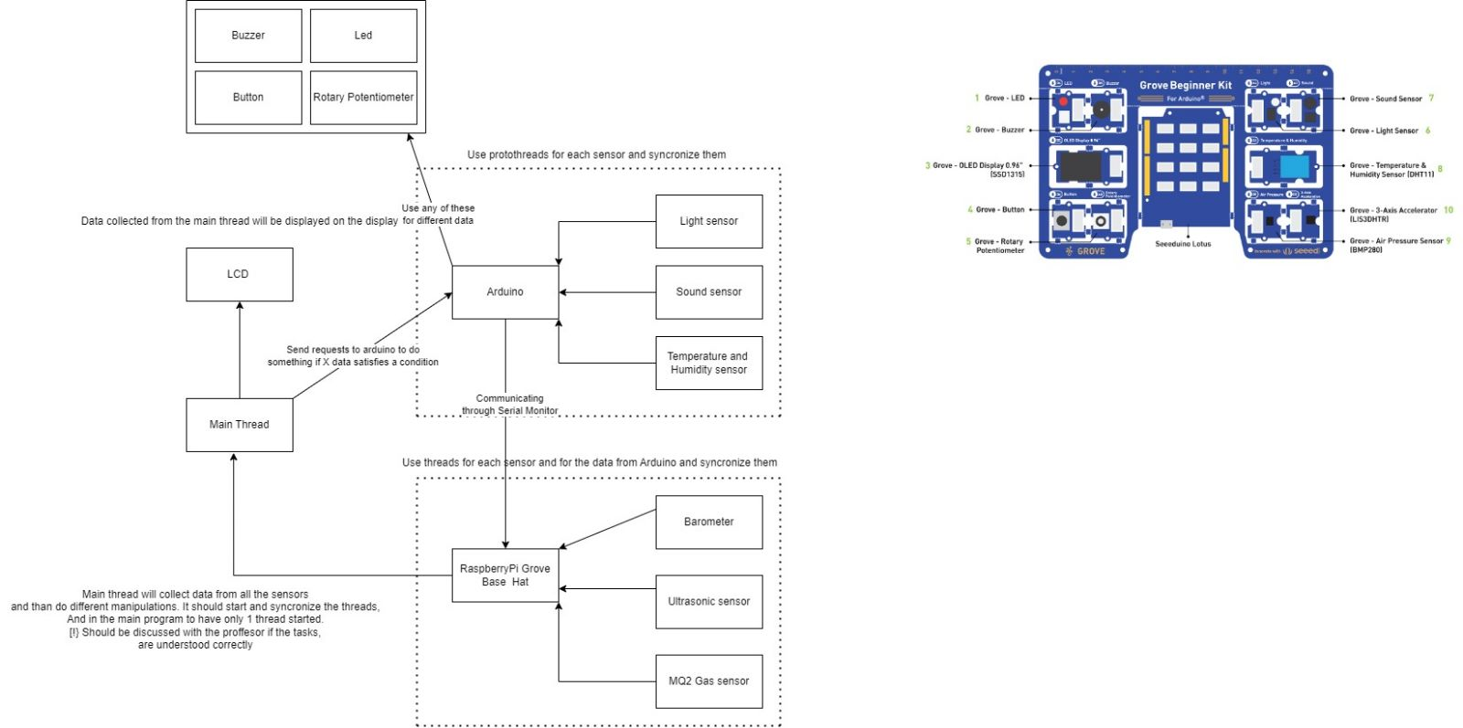
lsdjfjflojlfjdjdcsdfggdgddbdfvfdvvdfsfsfsddszsdfsdfdsfds

Slide 9
Sensors
Arduino
Raspberry Pi
Temperature and Humidity
Light
Sound
Barometer
Gas (Air Quality)
Ultrasound

Slide 10
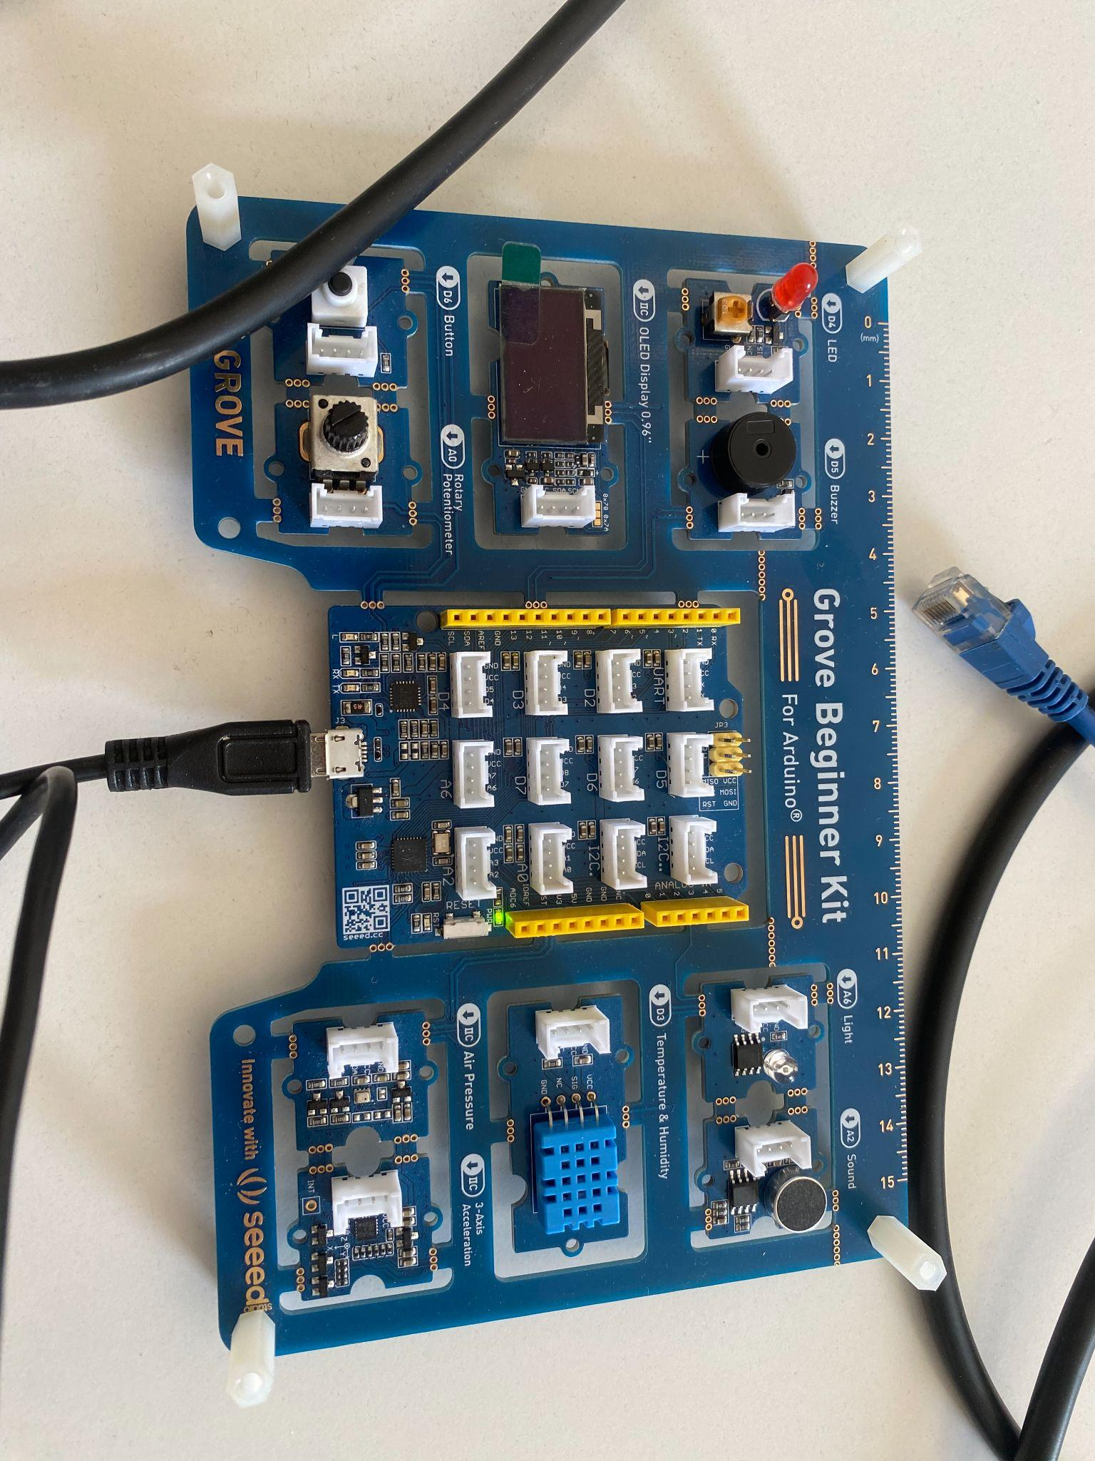
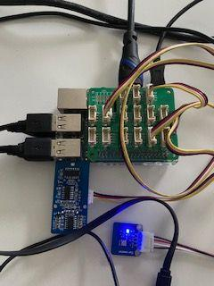
Arduino Grove Beginner Kit
Raspberry Pi

Slide 11
Threads
Barometer Ultrasound
Gas sensor
Arduino
Main
01
02
03
Arduino thread collects data from the Arduino sensors (temperature and humidity, light, and sound)
We have three separate threads for the above mentioned sensors
Main thread integrates all the threads and starts all the processes

Slide 12
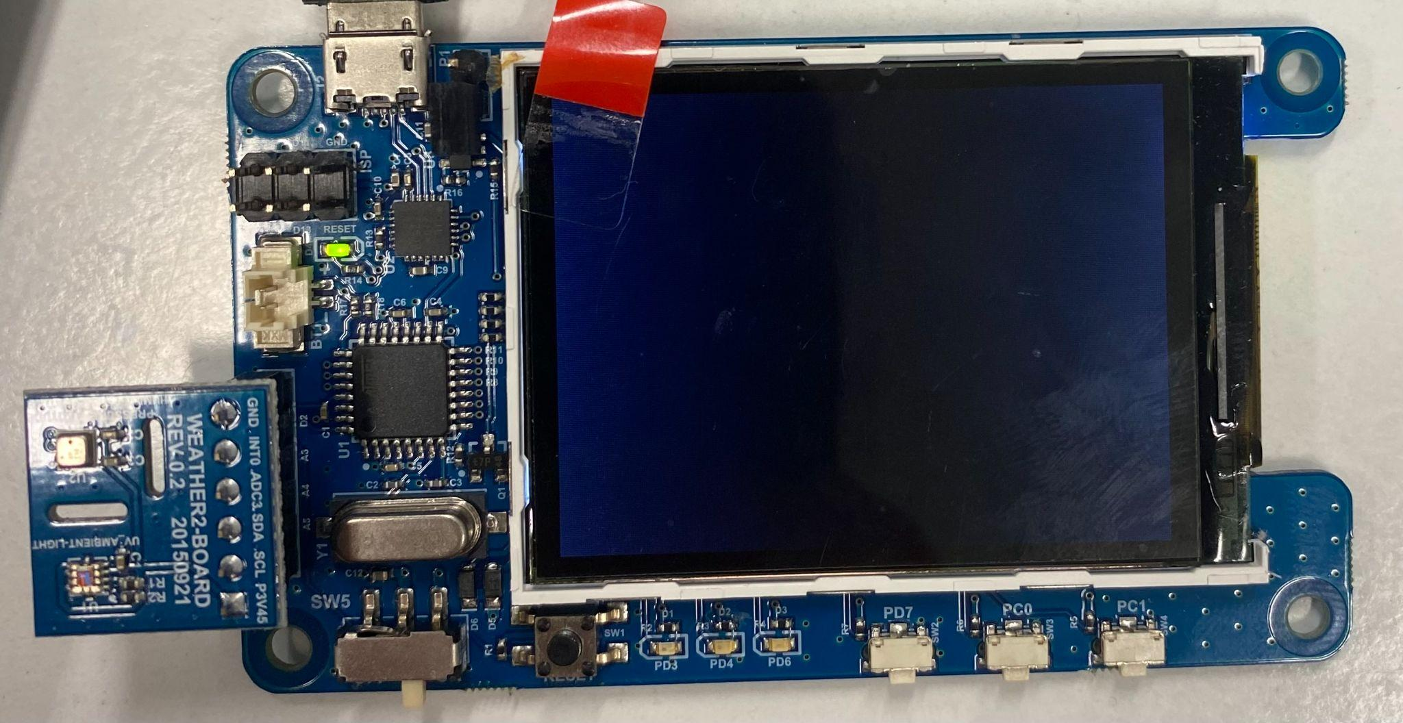
LCD Odroid Show-2

Slide 13
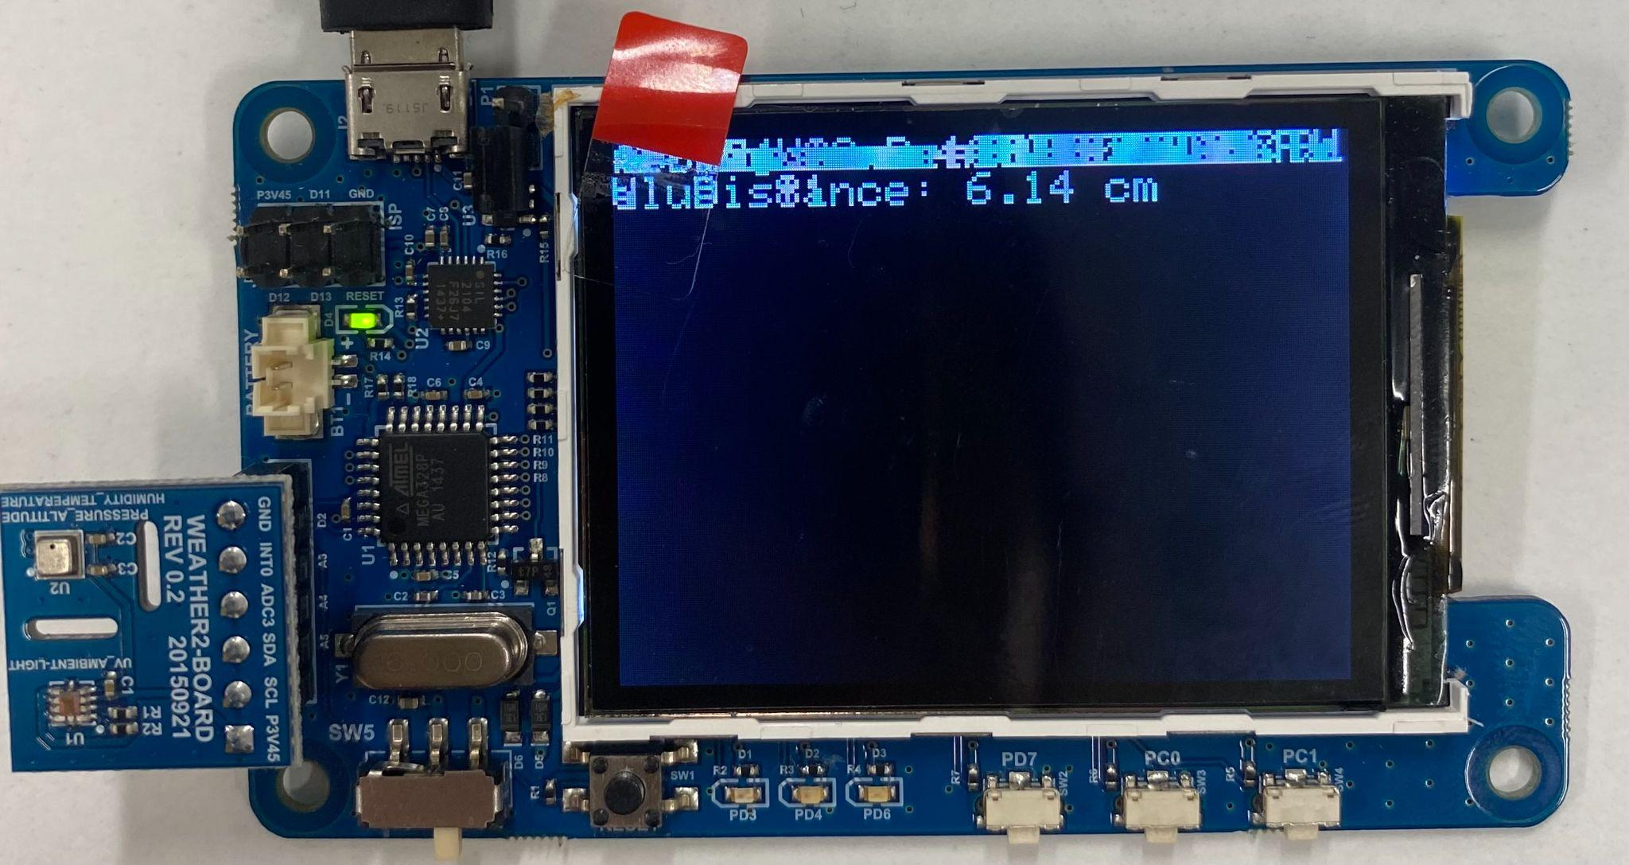

Slide 14
To solve this issue we used a shared library in C vt_100command.c and used Python to C Interface to integrate it into our program

Slide 15
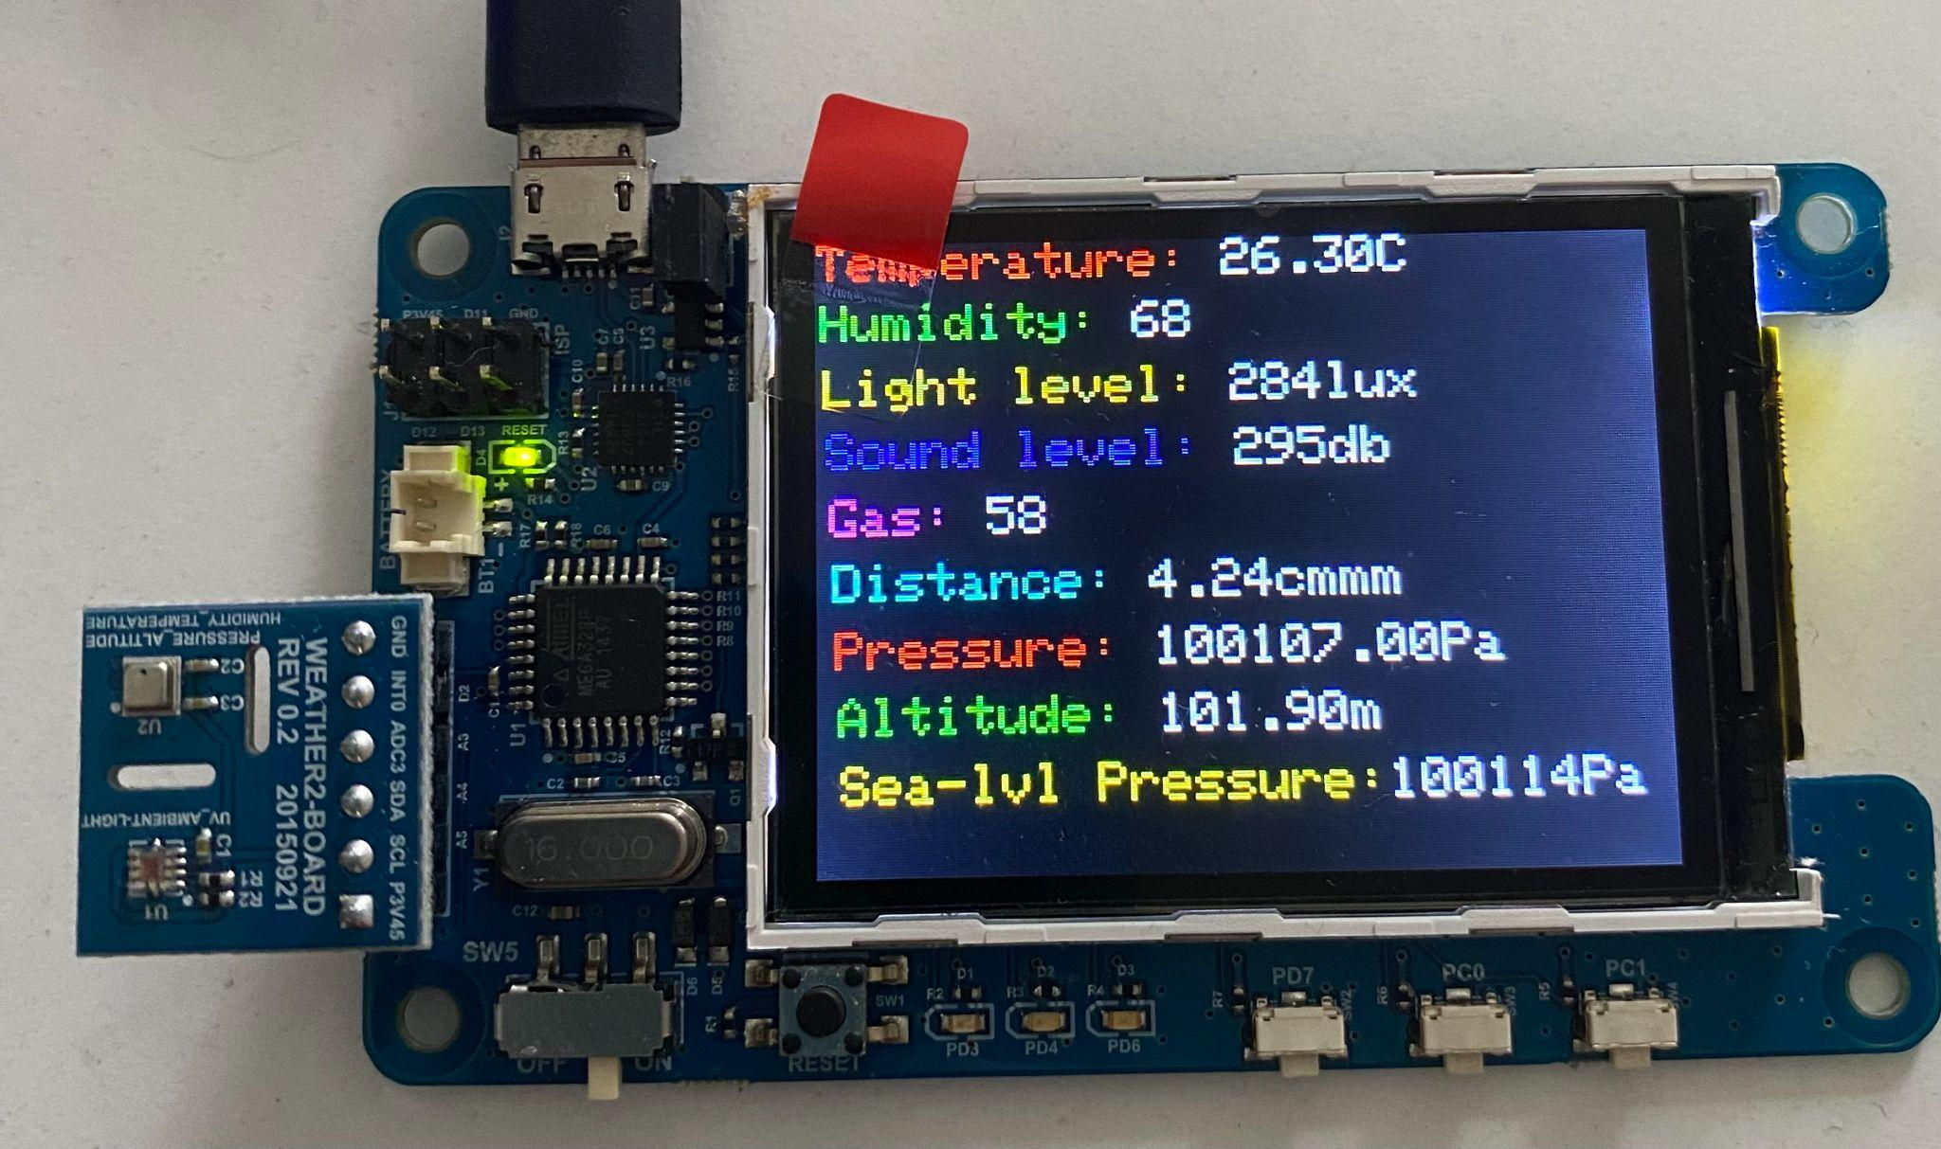

Slide 16
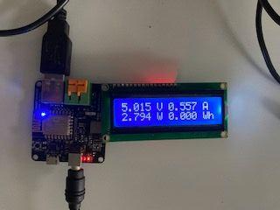
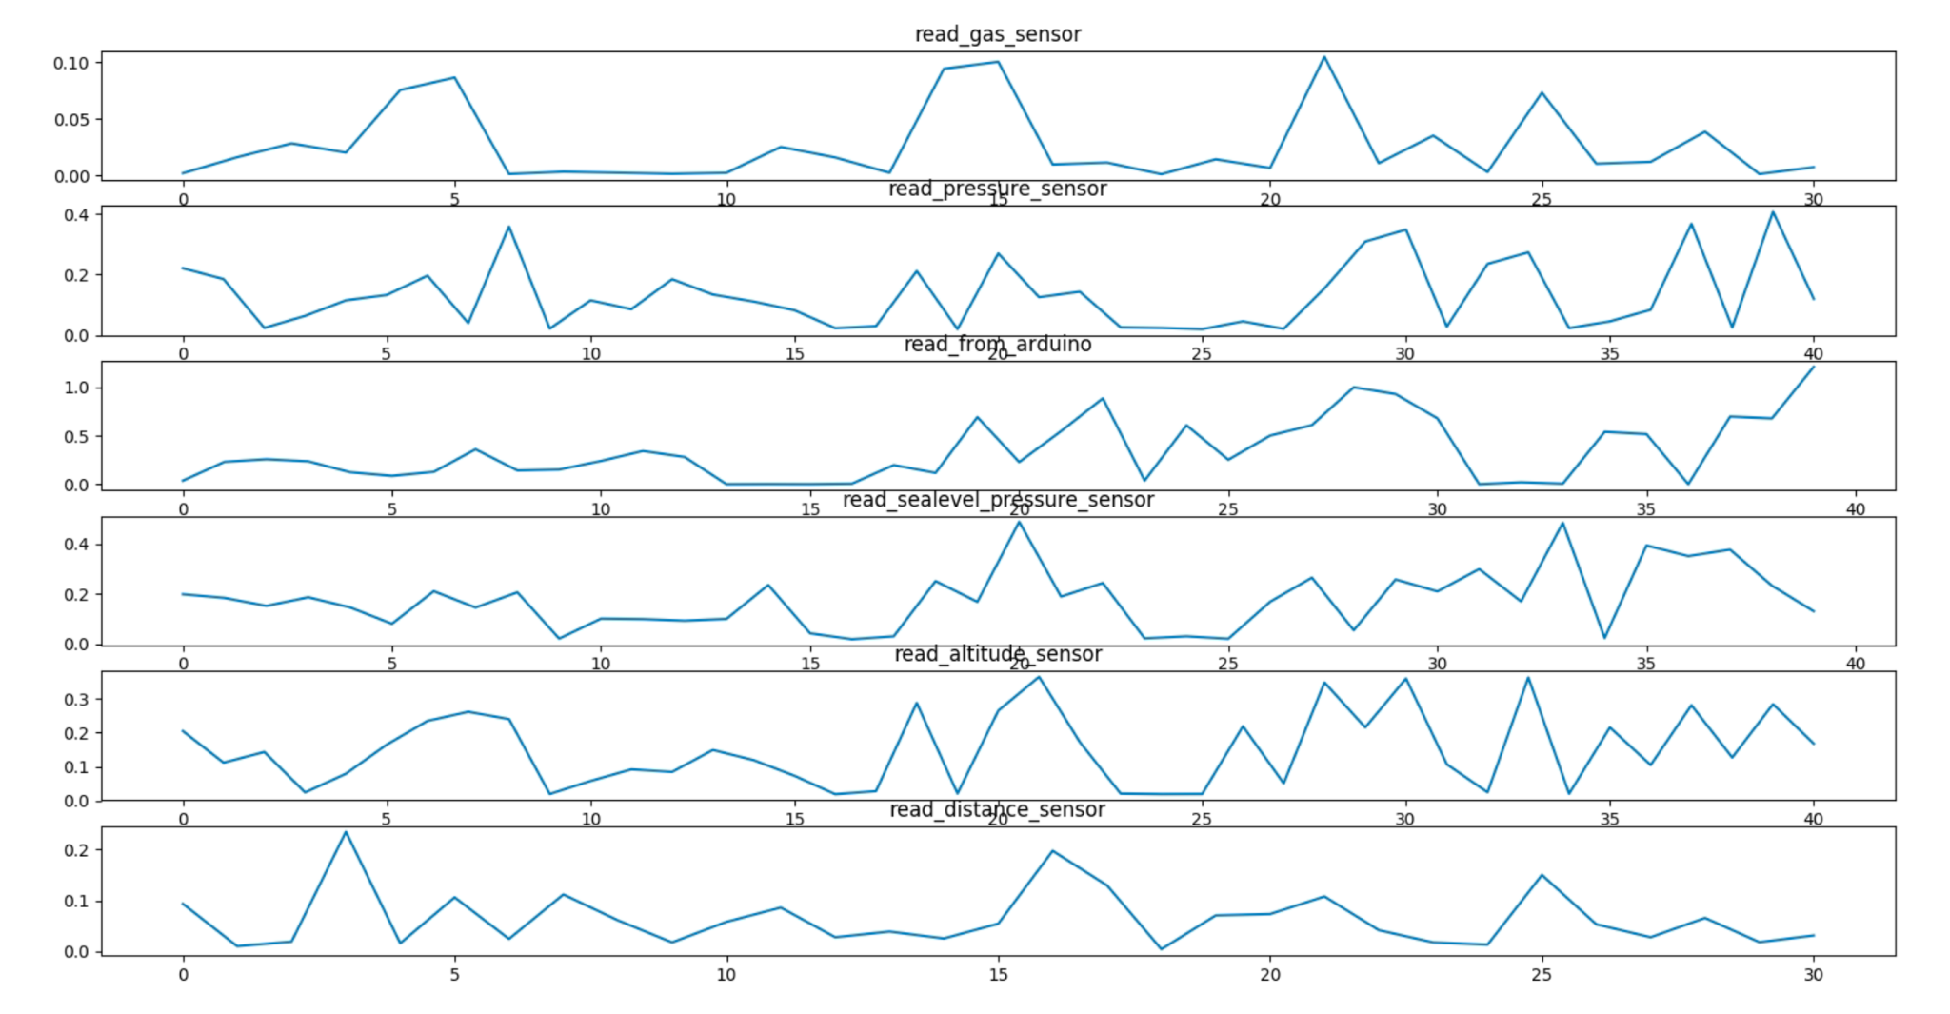
Results
Time
Energy
SmartPower2 5VDC Power Supply

Slide 17
For measuring the time we put a timer before reading and timer after reading, then we subtract the two values and send it in the buffer. We do the same for measuring the writing time

Slide 18
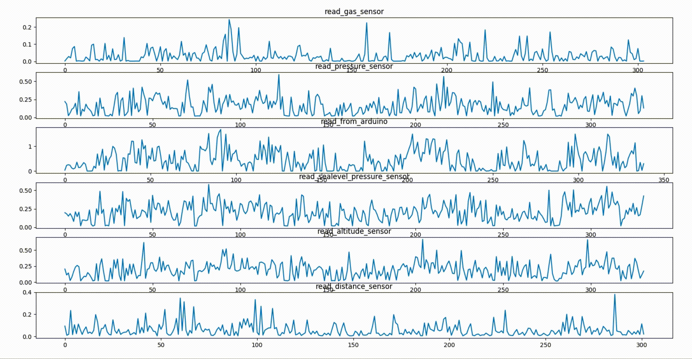

Slide 19
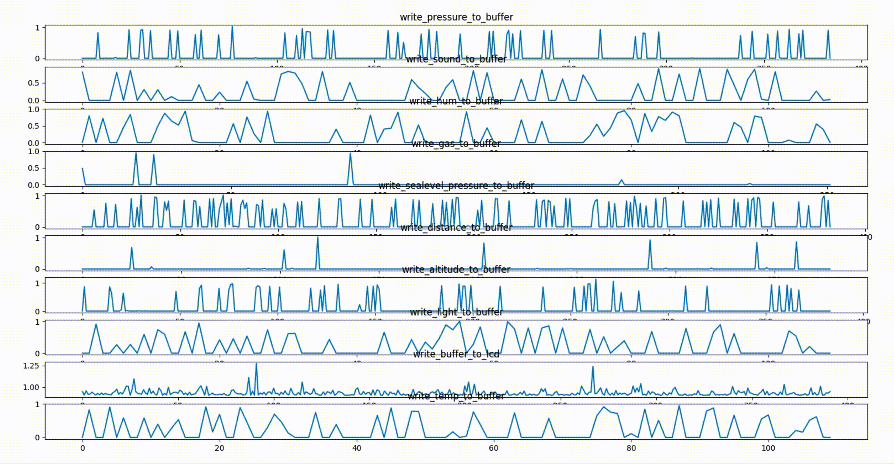

Slide 20
We measured the energy consumed by the system with Telnet, we read the values one by one and sent them to Xmgrace for graphing it. We update the graph every time a new value is read from telnet

Slide 21
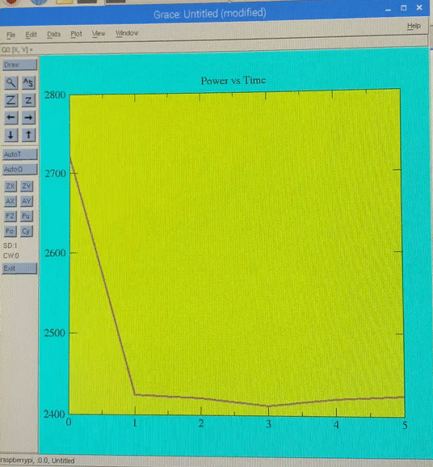
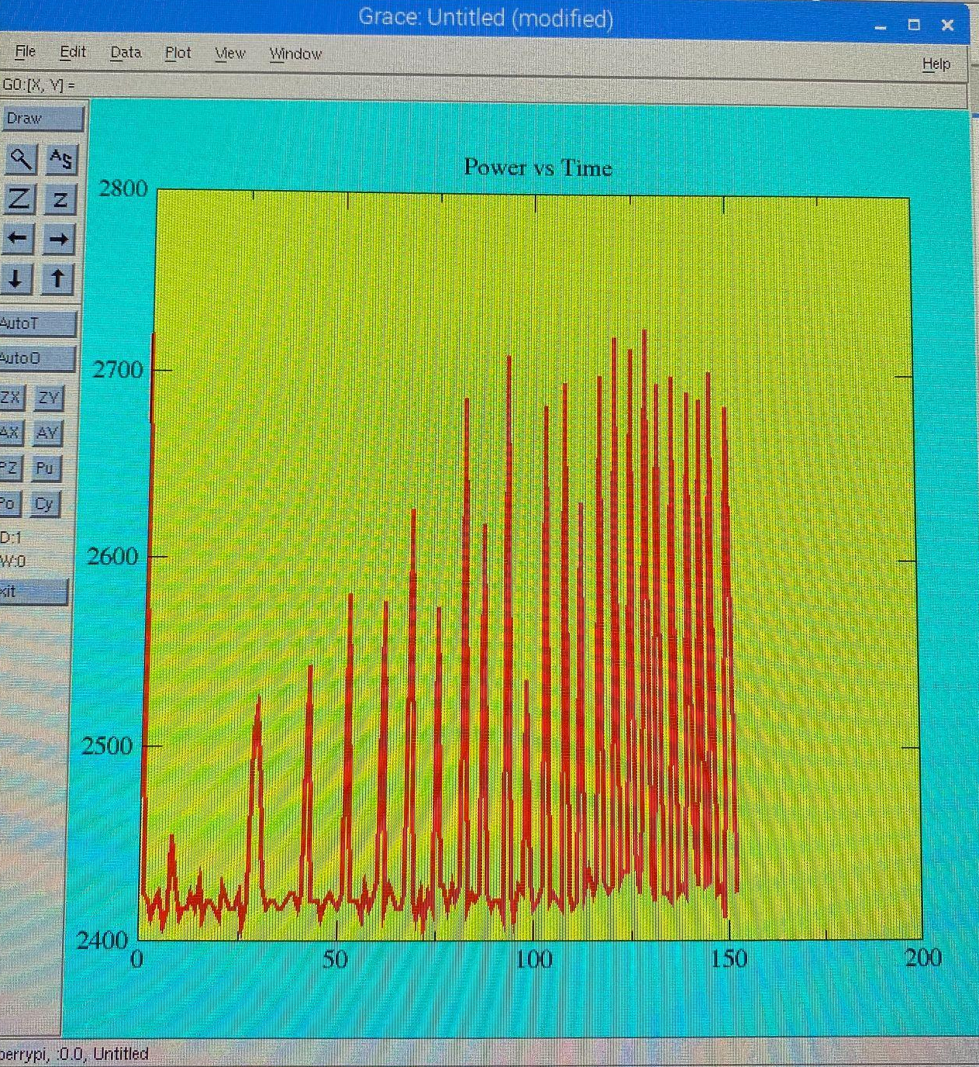

Slide 22
For measuring the energy consumed by individual components we measured the initial total energy consumed by the program, and then disconnected the components one by one, measured the energy and subtracted from the total

Slide 23
Energy Consumption
LCD
Arduino
Gas Sensor
Barometer
Ultrasound
Total (when both the python program and c program are executed)
359mW
156mW
66mW
7mW
34mW
878mW

Slide 24
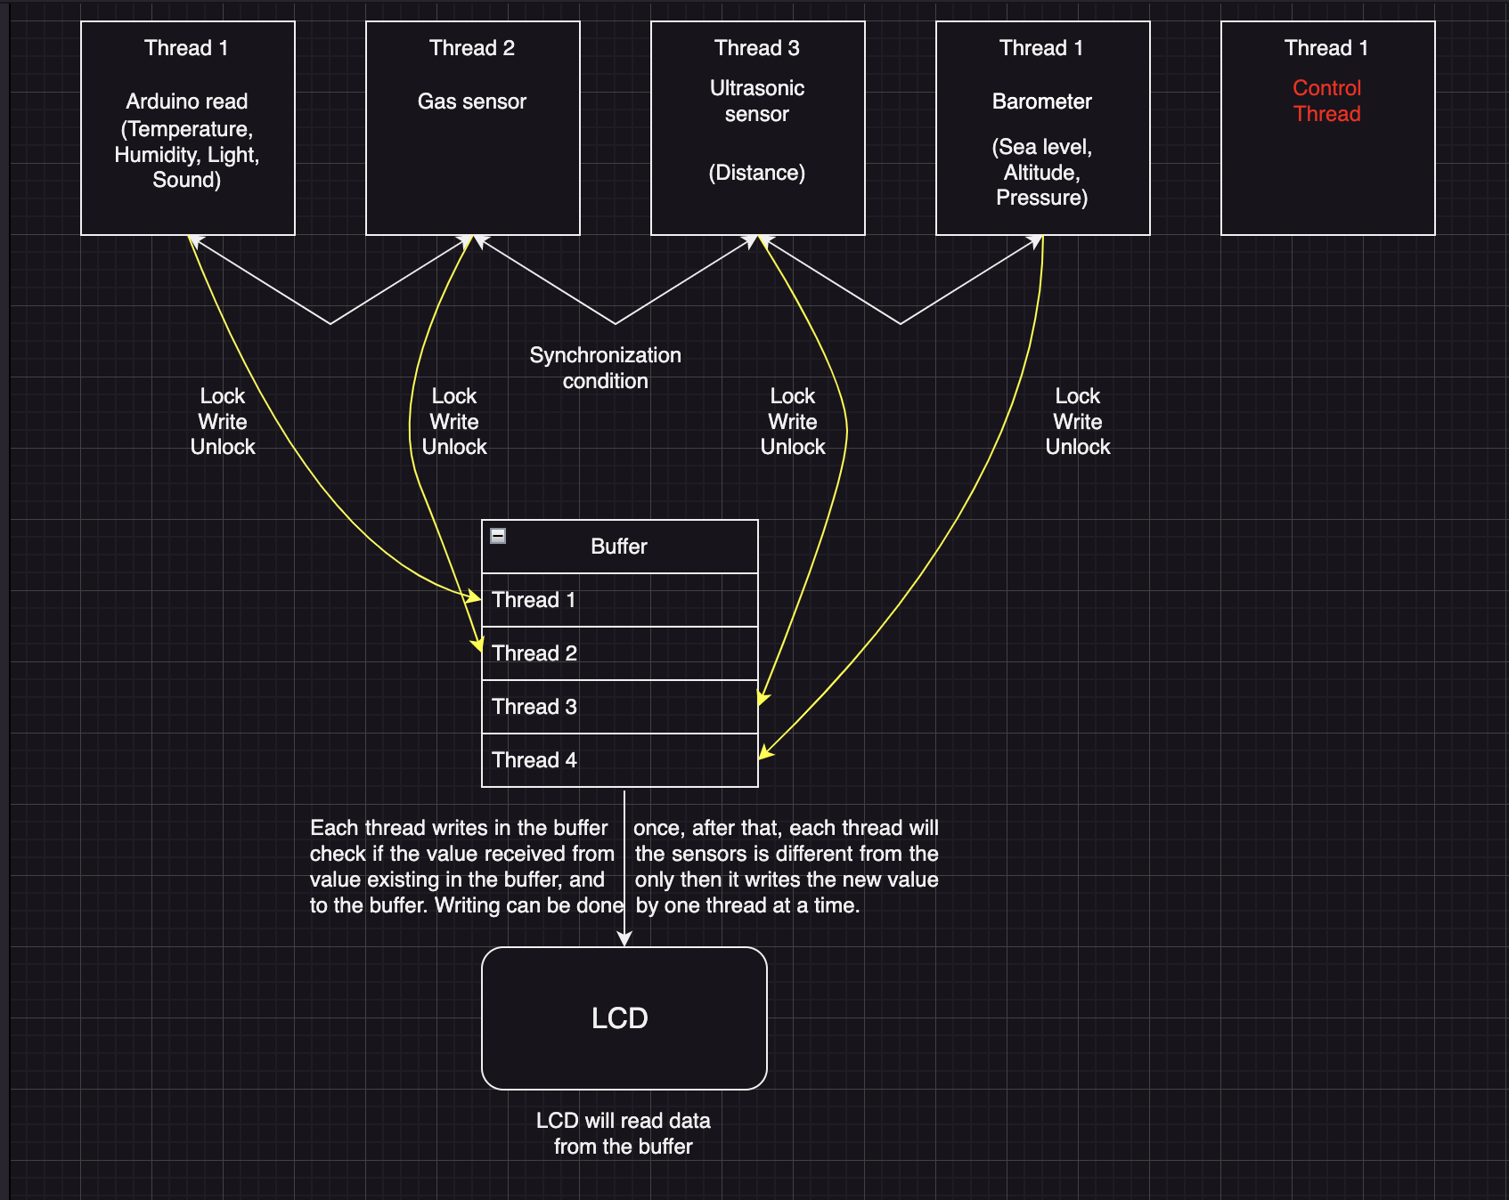
4

Slide 25
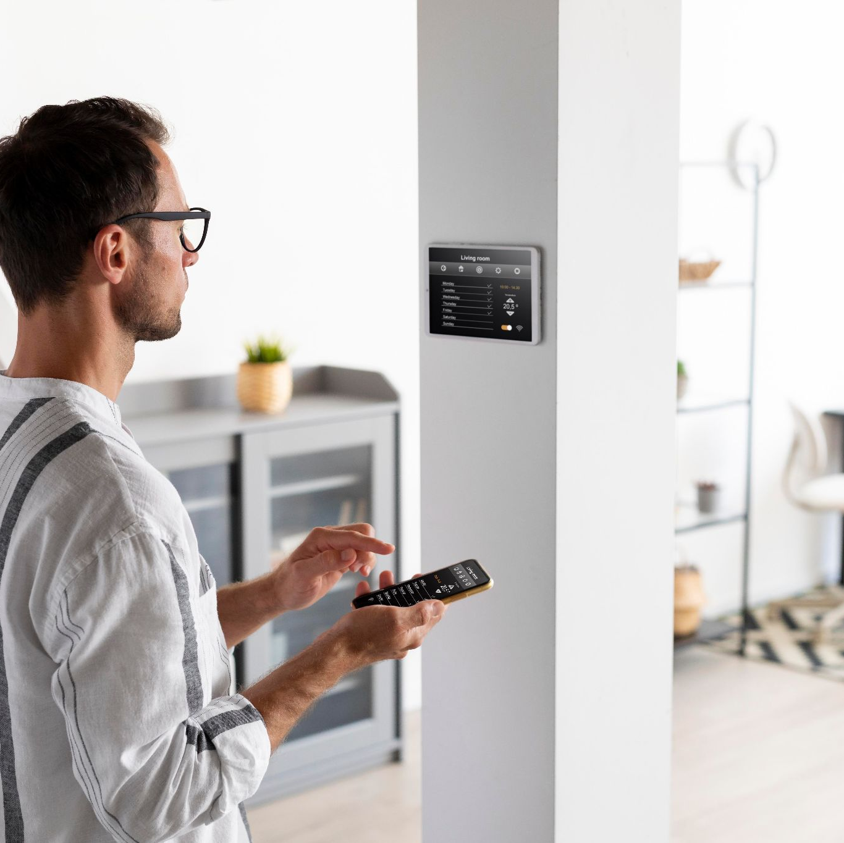
Future Development of the Project
-Energy Efficiency Monitoring
-Air Quality Monitoring and Control
-Integration with Personal Digital Assistant
-Security System
-Machine Learning and Predictive Analytics
-Expand Sensor Network

Slide 26
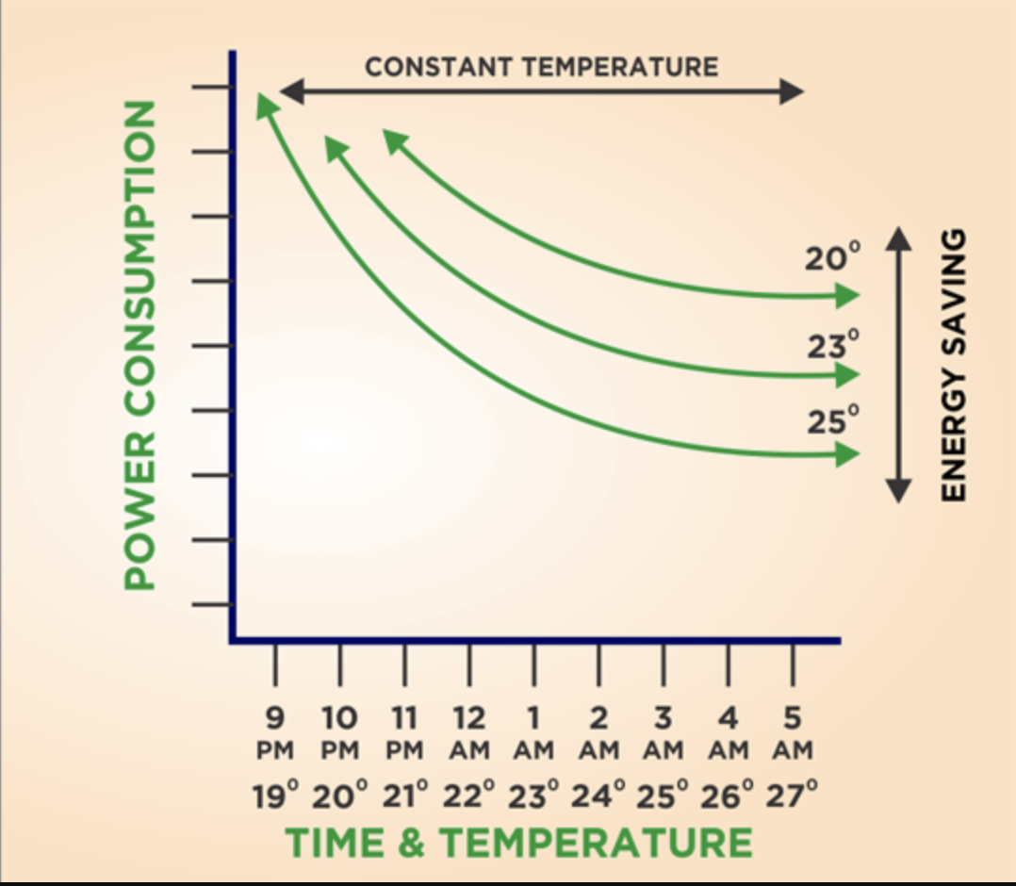
Energy Efficiency Monitoring
Optimizing Home Energy Consumption Using IoT
-Utilize light and temperature sensors to adjust home's heating and lighting system.
-Monitor energy usage patterns for identifying inefficiencies and eliminating waste.
-Automated adjustments for optimal energy consumption, based on sensor data.

Slide 27
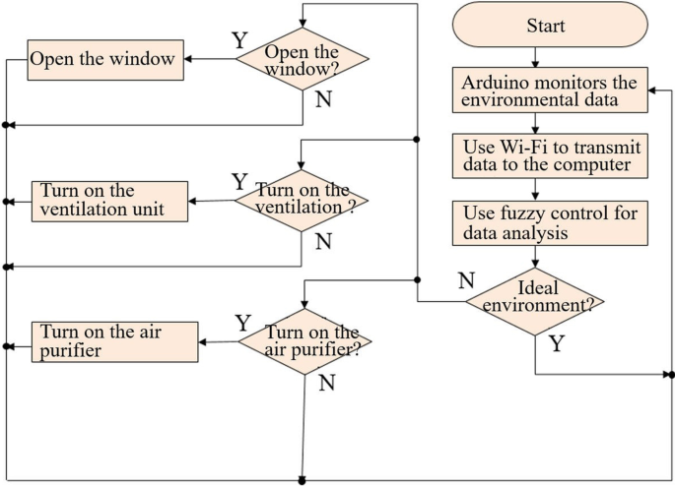
Air Quality Monitoring and Control
Ensuring a Healthier Home Environment
-Deploy gas sensor, barometer, and humidity sensor to monitor air quality.
-Alert system for when air quality drops (high CO2 levels, low humidity).
-Automated control of IoT devices like air purifiers or humidifiers for air quality improvement.

Slide 28
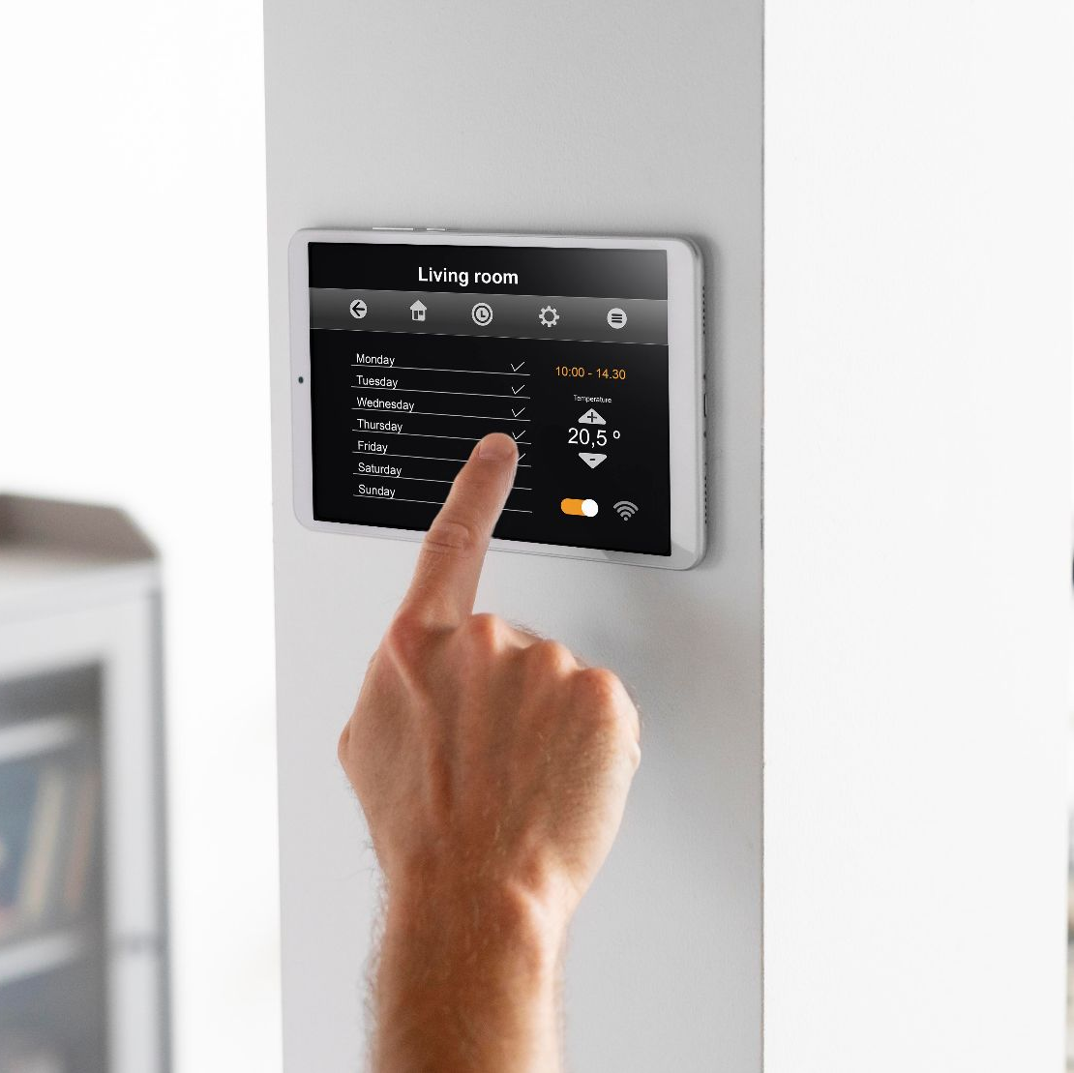
Integration with Personal Digital Assistant
Voice-Controlled Smart Home
-Enhance user interaction through compatibility with Siri, Google Assistant, or Amazon Alexa.
-Voice commands for checking home status and controlling home environment ("Increase the temperature", "Dim the lights").
-Enable users to access and control their smart home system in a hands-free manner.

Slide 29
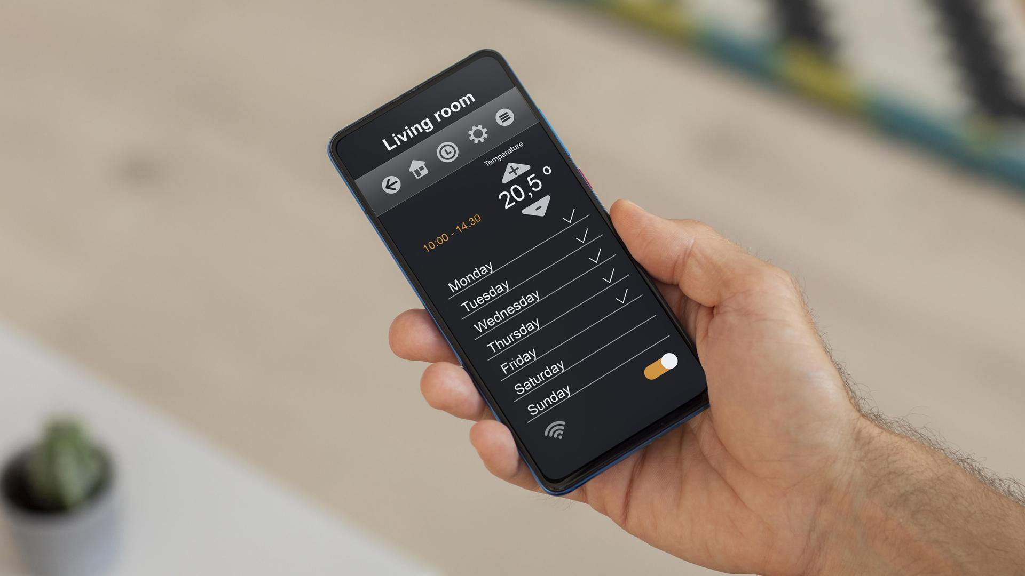
Developing a cross-platform application

Slide 30
THANK YOU!

Slide 31
REFERENCES

Slide 32
